Slide 1

Introduction to Search Problems in AI
This presentation will guide you through the exciting world of search problems in AI, explaining what they are, why they are important, and how they are used in various applications.

Slide 2
Defining a Search Problem
Definition:
Example: Google Maps
A search problem involves finding the optimal path from an initial state to a goal state. It is defined by key elements like initial state, actions, goal test, and path cost.
Imagine planning a road trip. Your current location is the initial state. The available routes you can take are the actions. Reaching your destination signifies the goal test. The distance, time, and traffic are the path cost.

Slide 3

Types of Search Problems: Uninformed Search
1
Breadth-First Search (BFS):
2
Depth-First Search (DFS):
3
Uniform Cost Search (UCS):
BFS explores all neighboring nodes at the current depth before moving to the next depth level. It is complete if the branching factor is finite and optimal if all step costs are equal.
DFS explores as far as possible along each branch before backtracking. It is not complete and may get stuck in infinite loops. It is also not optimal.
UCS expands the node with the lowest path cost. It is complete if the cost is greater than 0 and is optimal.

Slide 4
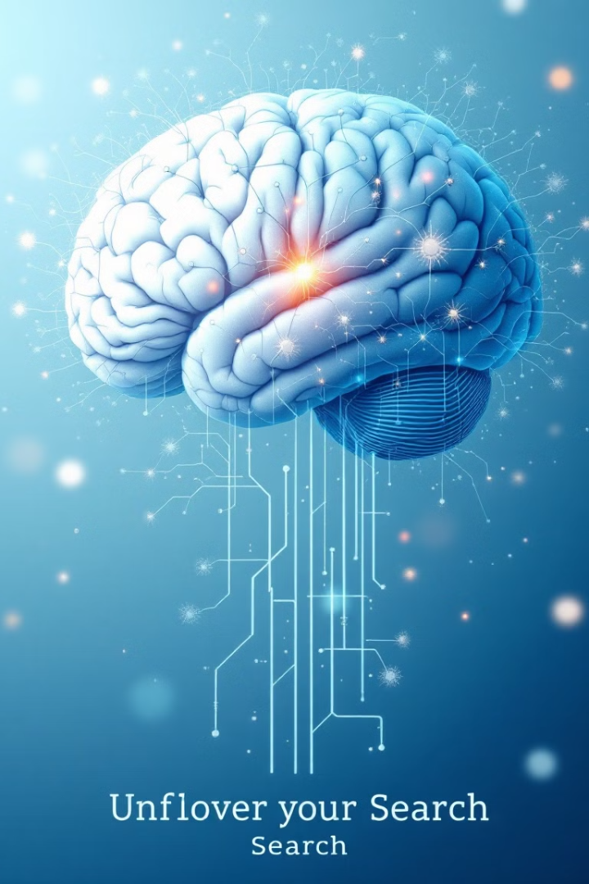
Types of Search Problems: Informed Search
1
Heuristic Function:
2
Greedy Best-First Search:
Heuristic functions estimate the cost from the current state to the goal state, providing valuable information for informed search algorithms.
Greedy best-first search expands the node that is believed to be closest to the goal based on the heuristic function. It is not optimal.
3
A* Search:
A* search combines the cost to reach a node with the estimated cost to the goal. It is complete and optimal under certain conditions.

Slide 5




Visualizing Search Algorithms
This visualization showcases how different search algorithms explore the search space. Understanding these visual elements is crucial for interpreting how each algorithm operates and makes decisions.
Nodes
Arrows
Highlighted Path
Color-Coding
Represent states in the search space. Each node signifies a possible state, with its position indicating its relationship to other states.
Represent actions between states. Arrows indicate the possible transitions or actions that lead from one state to another, forming the pathways through the search space.
Represents the explored path by the algorithm. The highlighted path shows the specific sequence of nodes and actions that the algorithm has evaluated in its search for the goal.
Indicates node status (unexplored, frontier, explored). Color-coding helps distinguish between nodes that are yet to be examined (unexplored), those that are candidates for exploration (frontier), and those that have already been visited (explored).

Slide 6
Challenges in Search: Complexity
Time Complexity:
Space Complexity:
Time complexity measures how long it takes to find a solution. It is often expressed using big O notation and depends on factors like branching factor and depth.
Space complexity measures how much memory is needed to perform the search. It is also expressed using big O notation and depends on the search algorithm's memory requirements.

Slide 7




Challenges in Search: Efficiency
Heuristic Design:
Admissibility and Consistency:
Local Optima:
In complex search spaces, algorithms can get stuck in local optima, where they may not be able to find the global optimum. This is a challenge that requires careful consideration.
A well-designed heuristic can significantly reduce the search space and improve efficiency. Poor heuristics can lead to suboptimal solutions or increased search time.
A* search requires admissible and consistent heuristics to guarantee optimality. Creating such heuristics can be a challenging task.

Slide 8

Conclusion
Search problems are crucial in AI, enabling intelligent decision-making in various applications. Understanding the strengths and weaknesses of different search algorithms is essential for choosing the most appropriate one for a given problem.

